Slide 1


Slide 2

What We will Cover in This Training
In this training we will cover the following topics:
What is Splunk
What Splunk Does
What you can do with Splunk
The different types of data you can import into Splunk
How you get all the data get into Splunk
Basic overview of Splunk Indexers/Indexing
Where Data is Stored in Splunk
Searching and the Search Bar
Search Basics including – Boolean & Comparison Operations
Breaking down the parts of a search query
Building queries that answer the When, Where and What.
Stats, Chart and Timechart commands, What’s the difference?
Building and saving your first Splunk dashboard
Additional training and reference sources

Slide 3
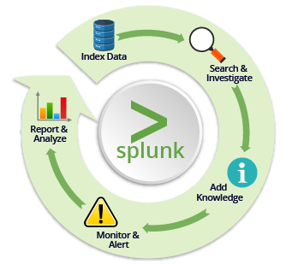
What is Splunk?
PROD: https://splunk.serve.com:8000
DEV: https://devsplunk.serve.com:8000
Splunk is a powerful tool for capturing, searching and indexing various types of machine data which will allow for better reporting, investigation, troubleshooting, monitoring and alerting on indexed data.

Slide 4
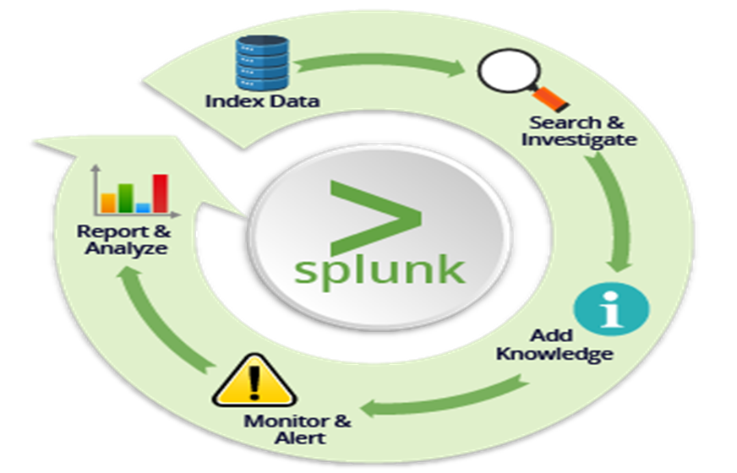
What does Splunk do?
Splunk correlates real-time data in a searchable repository from which it can generate graphs, reports, alerts, dashboards and visualizations. Think of it as a powerful analytical tool, which also has capabilities to store data in its own internal format for a specified amount of time.

Slide 5
What can I do with Splunk?
Gather Performance Data
Troubleshoot Application Issues
Automatically Alert on Error Conditions
Build Dashboards
Store and Retrieve data for Later Use

Slide 6
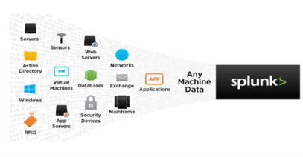
What sort of data is in Splunk?
Application logs - 77%
Firewall logs - 13%
Web server logs – 4%
Operating system logs – 3%
Mail server logs – 1%
Other logs – 2%

Slide 7
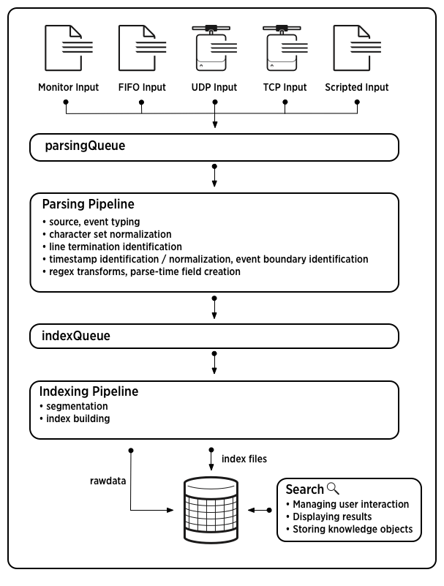
How did all that get in Splunk?
Splunk Forwarders
Windows app/security logs
IIS logs
DNS logs
Syslog
Application logs
Files
TCP/UDP sockets
Scripts/Scripted inputs
Database logs
Cisco Firewall manager

Slide 8
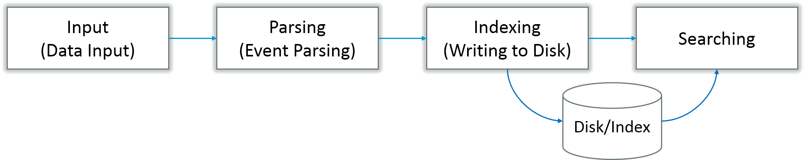
How Splunk works
Different Stages In Data Pipeline
There are 4 different stages in Splunk:
Data Input stage
Event Parsing (processes log contents sequentially and generates events)
Data Storage stage (Indexing)
Data Searching stage

Slide 9
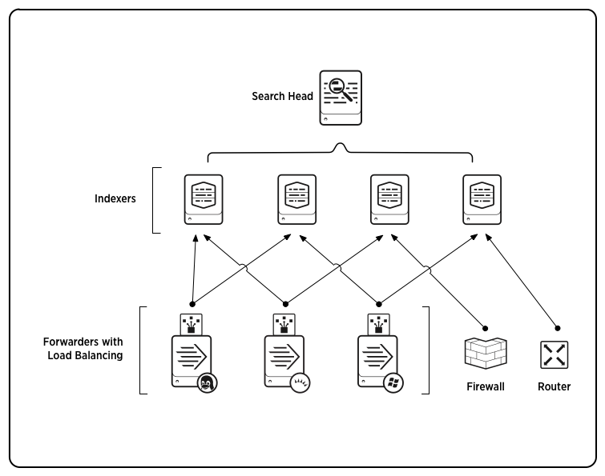
Splunk - Indexers
Indexers - The indexer is the Splunk Enterprise component that creates and manages indexes. The primary functions of an indexer are:
Indexing incoming data
Searching the indexed data
In some configurations, other Splunk Enterprise components take over the non-indexing roles. Forwarders consume the data, indexers index and search the data, and search heads coordinate searches across the set of indexers. Here's an example of a scaled-out deployment:

Slide 10
Splunk – What’s in an Index?
Splunk Enterprise stores all of the data it processes in indexes. An index is a collection of databases, which are subdirectories located in Splunk.
Indexes consist of two types of files: rawdata files and index files. See How Splunk Enterprise stores indexes.
Default set of indexes - Splunk Enterprise comes with a number of preconfigured indexes, including:
main: This is the default Splunk Enterprise index. All processed data is stored here unless otherwise specified.
_internal: Stores Splunk Enterprise internal logs and processing metrics.
_audit: Contains events related to the file system change monitor, auditing, and all user search history.
A Splunk Enterprise administrator can create new indexes, edit index properties, remove unwanted indexes, and relocate existing indexes. Splunk Enterprise administrators manage indexes through Splunk Web, the CLI, and configuration files such as indexes.conf. See Managing indexes.

Slide 11
Splunk-How the Data is Stored in Splunk?
Splunk stores data in a custom, purpose-built, multi-stage databases called indexes. An index is a collection of directories and files. Index directories are also called buckets and are organized by age. The main index, by default, holds all your events. The indexer also has a number of other indexes for use by its internal systems, as well as for additional Splunk search and reporting features.
Some common index names are:
main
production
Dev
By default, data that is fed to an indexer is stored in the main index, but you can create and specify other indexes for different data inputs. With a Splunk Enterprise license, you can add an unlimited number of additional indexes. The main index serves as the default index for any input or search command that doesn't specify an index, although you can change the default. You can add indexes using Splunk Web, the CLI, or indexes.conf.

Slide 12
How do I find what I’m looking in Splunk?
The Search Bar!

Slide 13
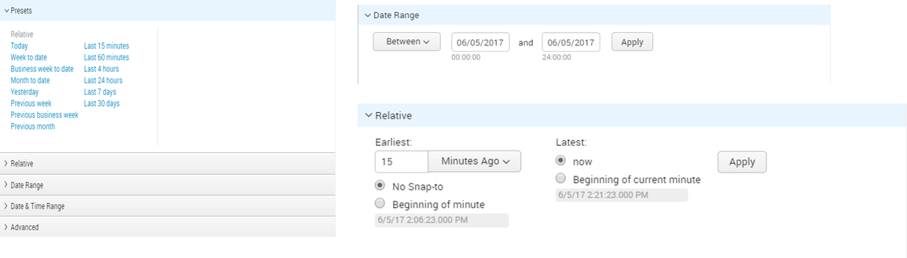
Splunk - Search Bar Basics
When?
Use the Time Picker to narrow you search.
Where?
Specify where the data is being requested or stored from like: Examples: Index=production or APPLICATION=xxx or COMPONENT=xxx
* Specifying “where” tells Splunk to where to look for data and which type of data.
What? What data does Splunk produce from logs? Key=value pairs.
You can use key value pairs for searches like LOGLEVEL=ERROR or status=deferred.

Slide 14
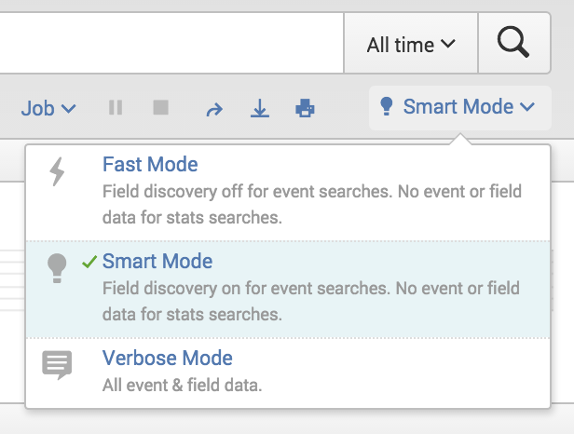
Using the appropriate search mode
Splunk Enterprise supports several search modes: (Do not use All time in your searches) Specify search time in your query or using the dropdown.
The Fast Mode gives you performance over completeness. On the converse, the Verbose Mode gives you completeness over performance. The Smart Mode (default) is a combination of Fast and Verbose modes. It is designed to give you the best results for your search with the field discovery turned on (like in the Verbose Mode) to extract all possible fields while reporting as configured in the Fast Mode.

Slide 15

Splunk – Search Basics
Index= production - specifies which index to search
sourcetype=gnsProcessing (Key value pair 1)
LOGLEVEL=ERROR (Key value pair 2)
Putting it all together:
index=production sourcetype=gnsProcessing LOGLEVEL=ERROR
* Splunk parses key values in some set-format logs based on known field locations.

Slide 16

Search Basics – Boolean & Comparison Operations
Boolean Operations must be in all caps. “AND” is the default. AND OR NOT
Example of Boolean Operation: Index=production host=tpaqwbsl* OR host=tpauwbsl*
Comparison Operators: >,<,>=, <=
Example: index=production status >=500 AND duration >3

Slide 17
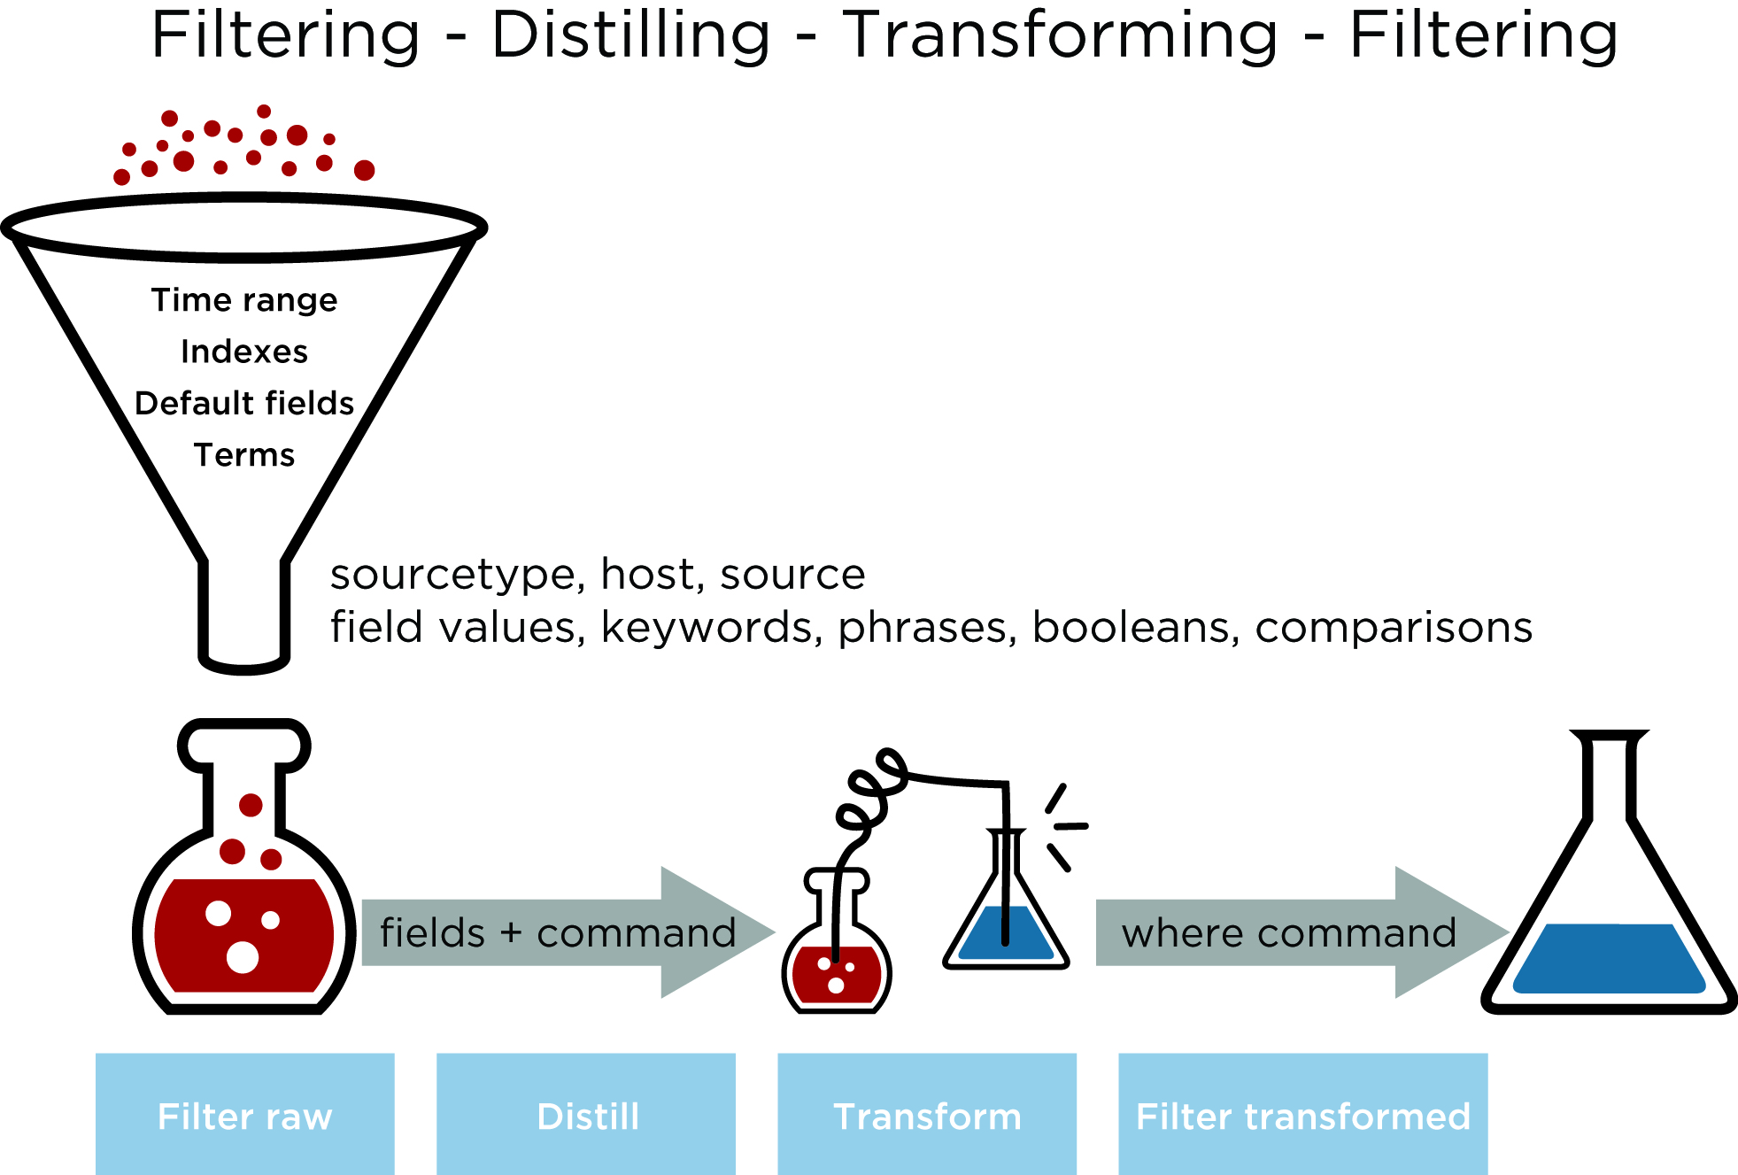
Splunk - A process model for search
To better understand the way search works in Splunk Enterprise, consider the following figure, which represents a conceptual search process model.

Slide 18

Splunk - Distilling searches using simple searches
To get an even better understanding of your data, you'll need to use fields. When you run simple searches based on arbitrary keywords, Splunk Enterprise matches the raw text of your data. A field can also be a name-value pair, where there is a single value assigned to the field. A field can also be multivalued, where it occurs more than once in an event and can have a different value at each occurrence.
Fields are searchable name-value pairs that distinguish one event from another. Because not all events have the same fields and field values, searches with fields are more targeted and retrieve more exact matches against your data.
Field names are case sensitive but field values are not. Here's an example of a search to check for errors, which doesn't use fields:
error OR failed OR severe OR (sourcetype=access_* (404 OR 500 OR 503))
And the same search using fields:
error OR failed OR severe OR (sourcetype=access_* (status=404 OR status=500 OR status=503))
So, The first example is likely to return more results than the second. When you run simple searches based on arbitrary keywords, the search matches the raw text of your data. The second example returns only those results that have those specified values for the status field.

Slide 19
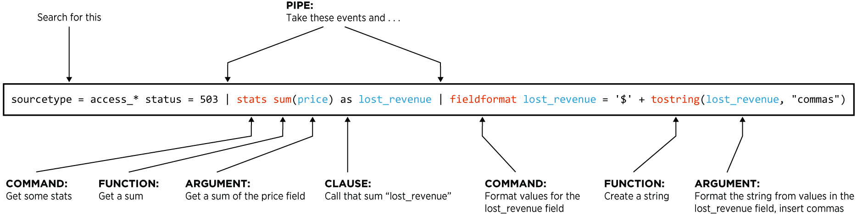
Splunk Query breakdown
Splunk searches are made up of 5 basic components:
Search terms - what are we looking for? Keywords, phrases, Booleans, and so on.
Commands - what should we do with the results? Create a chart, compute statistics, evaluate, apply conditional logic and format, and so on.
Functions - how should we chart, compute, or evaluate? Get a sum, get an average, transform the values, and so on.
Arguments - are there variables we should apply to this function? Calculate average value for a specific field, convert milliseconds to seconds, and so on.
Clauses - how should we group the results? Get the average of values for the price field grouped by product, and so on.
The following diagram represents a search broken into its syntax components:

Slide 20
Splunk Query breakdown (Pt.2)
Search command
The search command is the simplest and most powerful SPL command. It is invoked implicitly at the beginning of a search.
When it's not the first command in a search, the search command can filter a set of results from the previous search. To do this, use the search command like any other command, with a pipe character followed by an explicit command name. For example, if we augment the previous search, it will search for the Web log events that that have the term "error," find the top URIs, and filter any URIs that only occur once.
Example: index=production sourcetype=access_combined | top uri | search count>1
Keyword arguments to the search command are not case-sensitive, but field names are.
Event
An event is a single data entry, or key-value pair associated with a timestamp. Specifically, an event is a set of values associated with a timestamp. For example, here is an event in a Web activity logfile:

Slide 21
Splunk Query breakdown (Pt.3)
Example: 173.26.34.223 - - [01/Jul/2009:12:05:27 -0700] "GET /trade/app?action=logout HTTP/1.1" 200 2953
While many events are short, a line or two, some can be long, for example: a full text document, a configuration file, or java stack trace. Splunk Enterprise uses line-breaking rules to determine how to delineate events for display in search results.
Splunk Enterprise is intelligent enough to handle most multiline events correctly by default. In rare cases it doesn't, see "Configure event line breaking" for information on how to customize line breaking behavior.
Field
Fields are searchable name/value pairs in event data. As events are processed at index time and search time, fields are automatically extracted. At index time, a small set of default fields are extracted for each event, including "host," "source," and "sourcetype." At search time, Splunk extracts a wider range of fields from the event data, including obvious name-value pairs, such as "user_id=jdoe," and user-defined patterns.
Host
A host is the name of the device where an event originates. A host provides an easy way to find all data originating from a particular device.

Slide 22
Splunk Query breakdown (Pt.4)
Source/Sourcetype
A source is the name of the file, stream, or other input from which a particular event originates. For example, "/var/log/messages" or "UDP:514." Sources are classified by sourcetype, which can either be well known, such as "access_combined" in HTTP Web server logs, or can be created on the fly when a source is detected with data and formatting not previously seen. Events with the same sourcetype can come from different sources. Events from the "/var/log/messages" file and events from a syslog input on udp:514 can both have "sourcetype=linux_syslog".
Eventtype
Eventtypes are cross-referenced searches that categorize events at search time. Eventtypes are essentially dynamic tags that get attached to an event if it matches the search definition of the eventtype. For example, if you defined an eventtype called "problem" that has a search definition of "error OR warn OR fatal OR fail", any time your search result contains "error," "warn," "fatal," or "fail," the eventtype value is "problem".
Tag
A tag is a field value alias. For example, if two host names refer to the same computer, you could give both host values the same tag, such as "hal9000", and when you search for the "hal9000" tag, events for all hosts having that tag are returned.
Tags are useful when normalizing data at search time. See "Tagging our Events" in "Working with data: Where it comes from and how we manage it" for an example of tagging in action.

Slide 23

Stats, Chart and Timechart command differences
Stats | Chart | Timechart
Stats is a reporting command which is used to present data in a tabular format. | Chart displays the data in the form of a bar, line or area graph. It also gives the capability of generating a pie chart. | Timechart allows you to look at bar and line graphs. However, pie charts are not possible.
In Stats command, you can use multiple fields to build a table. | In Chart, it takes only 2 fields, each field on X and Y axis respectively. | In Timechart, it takes only 1 field since the X-axis is fixed as the time field.

Slide 24
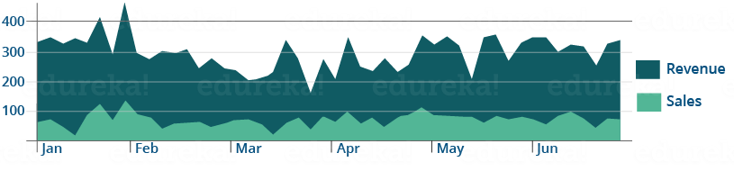
Using the Splunk timechart command
A little about Splunk Timechart and where it can be used. Splunk Timechart can be used to analyze data if the performance metrics has had an increasing or a decreasing trend over time.
Splunk Timechart refers to visualization of any data with respect to time. In Timechart, data is represented in the form of line, area or column charts which is plotted against x-axis that is always a time field, whereas y-axis is the variable field. if we had to create the Timechart for both sales and revenue numbers of an apparel chain on a monthly basis, we can plot sales and revenue on the y-axis and time on x-axis. The Splunk Timechart visualization would look like:
Splunk Timechart is often compared to Stats and Chart commands. The underlying structure between the three commands are quite different, you can refer to the table which explains the difference between them. Now, you know how data can be visualized using Splunk Timechart.

Slide 25
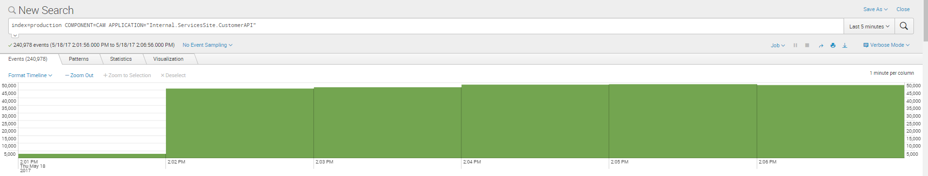
Splunk Search Results - Timeline
Interactively shows number of events per time increment. AND you can mouse-over the results in the events tab for more specific information and time segments that you can click/click and drag to look at results for individual or group of segments.

Slide 26
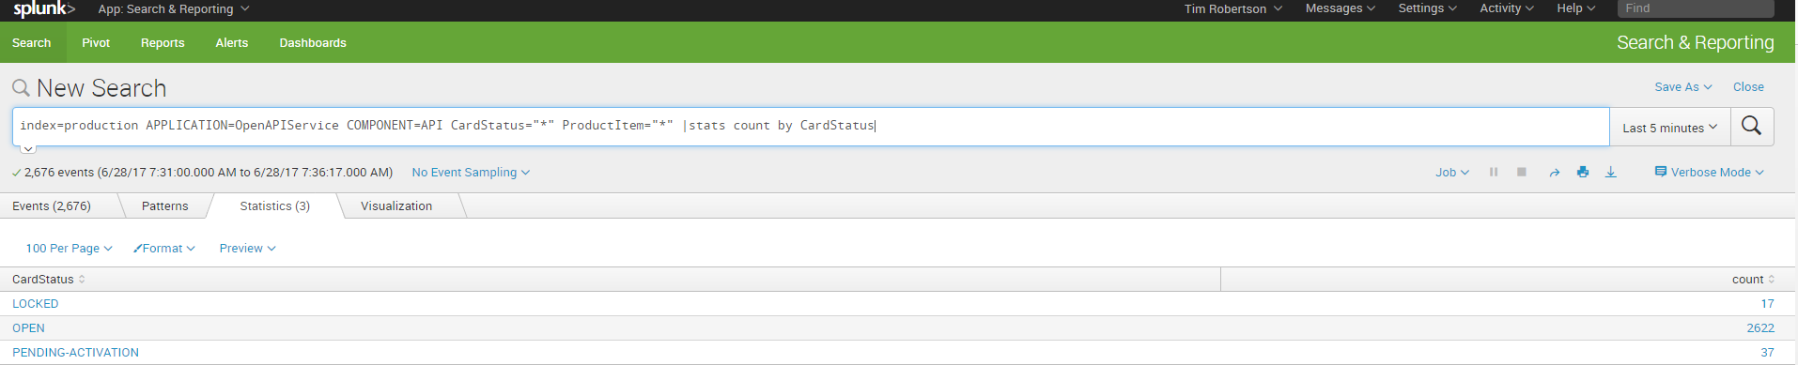
Building your first Splunk dashboard
So now you have the components of a query and you’ve identified what where and when you want to search, now what?

Slide 27
Building your first Splunk dashboard 2
Start by inserting whatever query you want for your first dashboard panel and set the timeframe like example below:
Next, Click on the magnifying glass to run the query you just created in Splunk (don’t forget to set the correct timeframe for searching)
After the query search is completed, in the top right corner of the search window, Select Save As, Then Select Dashboard Panel.
In the Save As dashboard Panel window, Under Dashboard - Select NEW
Give the Dashboard A title (a name specific to the search you ran)
Under Dashboard Permissions, decide if you want to share the dashboard, or keep it private (only you can see it)
Under Panel content, select what type of display you want for the dashboard chart type (Statistics, Line)
Click Save. Document the location it saved it to. See screenshot below:

Slide 28
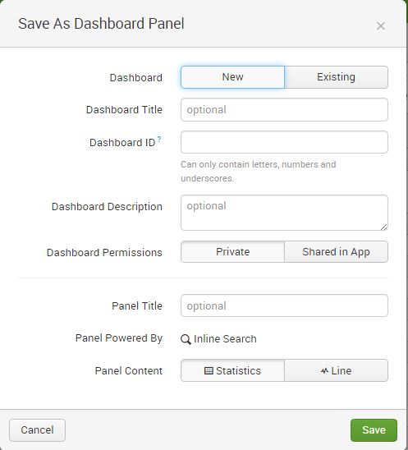
Building your first Splunk dashboard 3
Make sure to complete the below boxes. This tells Splunk where to save the dashboard, a brief description of what the dashboard represents and whether or not it is share with others or private and the type of dashboard (graphical chart or just statistics)

Slide 29
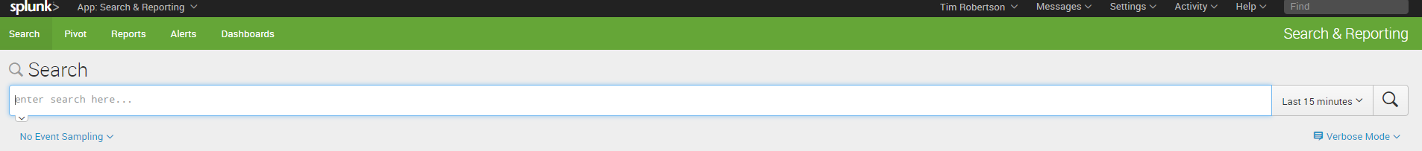
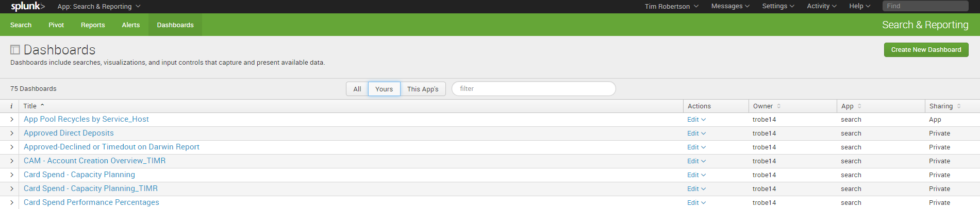
Opening your first Splunk dashboard
In the main Splunk search window: https://splunk.serve.com:8000/en-US/app/search/search select Dashboard above the search bar as shown below:
Next, make sure the button left of the filter box is selected as Yours and this will provide results of all your individual dashboard listed under your user credentials.

Slide 30


In Summary
More Information about Splunk:
http://docs.splunk.com
https://answers.splunk.com/index.html
User guides,
Reference materials
Tutorials
Community Tutorials

Slide 31
Splunk Query Examples
index=production (COMPONENT=API "API_CONSUMERKEY=TaxAct" API_ACTION=CustomerPUT PRODUCT_ITEM="TAXACT") |bin _time span=1d |stats count by _time, API_ACTION Range (Feb 1-Feb 3 2017)
index=production source=udp:9082 sourcetype=gnsProcessing EventId=GWOut MessageType=PosAuthorization | stats count as MessageType | rangemap field=MessageType low=0-150000 elevated=15001-180000 default=severe Range (last 60 mins)
index=production LOGGER!=*Configuration* COMPONENT=CST host=CLTPWCAT* LOGLEVEL=ERROR | chart count by LOGMSG

